Slide 1
BATCH CLAIMS: What are they? and why you should care!
March 5, 2020
David P. Kreppein, Esq. AVP TransRe

Slide 2
Agenda
Overview of “Batch” Claims & Background
Claim Types and Theories
Emerging Losses
Risk Management Strategies to prevent/mitigate potential exposures
Notes:
Lainie

Slide 3
Overview
Batch claims are interrelated claims with multiple claimants and similar factual allegations.
Batch claims are being reported with ever increasing frequency and severity.
Types of batch claims can vary from products liability, unnecessary surgeries, improper sterilization of instruments to sexual abuse and murder.
Batch claims can be horrific and garner significant media attention.

Slide 4
Overview cont’d.
There can be significant coverage issues on batch claims.
Criminal/intentional acts or products liability exclusions.
No hospital is immune from these losses. These types of exposures affect both large Hospital systems/ University Hospitals as well as rural and community hospitals. City, suburb or rurally located hospitals have all faced batch losses.
Through good investigation and proactive risk management, these losses can be mitigated or prevented.

Slide 5
Claim Types/Theories
Claim Types/Theories
Rogue Employees
Sexual abuse/misconduct
Angel of death; drug addiction-related offenses
Product/Equipment Failures
improper sanitation and sterilization practices;
Malfunction of medication dispensing or radiation equipment
“Financial Gain” Claims
Medical necessity
Unnecessary procedures
Common thread: misfeasance in delivery of professional medical services to a large number of patients. Resulting lawsuits are typically based on legal theories of direct corporate negligence by the Healthcare Organization or, alternatively, on vicarious liability theories.
Notes:
Lainie

Slide 6
Rogue Employees – Most Prevalent
Description
Drug seekers or sexual predators who victimize a large number of patients
Many use their considerable influence (in the community) to get away with crimes for years, sometimes decades
Victims are minors or young adults or elderly
Theories against hospitals
Negligent credentialing
Negligent supervision
Direct or vicarious liability
Illustrative Cases
Dr. Levy (8,000 to 10,000+ OB/GYN patients videotaped community health clinic) (Baltimore County, MD)
Dr. Bradley (rape/child abuse affecting up to 7,000 patients)(Newcastle, DE)
Dr. Nassar (250+ sexual assault of minors, including Olympic gymnasts) (East Lansing, MI)
Dr. Tyndall (18,000 students/patients sexually assaulted by USC OB/GYN) (Los Angeles, CA)
Dr. Barto (sexual abuse/assault of at least 31 children at his pediatric clinic and local hospital) (Johnstown, PA)
Kwiatkowski (temp nurse infected 200+ patients with Hep C at Exeter/Triage Staffing)(Rockingham, NH)
Kristen Parker (surgical tech infected approximately 30 patients at Rose Medical Center, 4,700 patients notified) (Denver County, CO)
Vickie Dawn Jackson (nurse injected patients with paralytic agent resulting in death of at least 10 patients, possibly 20) (Nocona, TX)
Notes:
Rich

Slide 7
Rogue Employees (con’t)
Illustrative Issues:
Criminal v civil allegations
Availability of coverage & exclusions (criminal acts)
Trigger of multiple insurance towers/years
Trigger of multiple insurance coverage sections (PL/GL) and/or policy types (PL/GL, D&O, Cyber)
Public relations
Notes:
Rich & Kristin

Slide 8
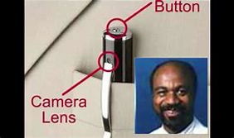
Dr. Levy – Johns Hopkins Hospital (Baltimore, MD)
Well respected OB/GYN videotaped patients during examinations for over 25 years at East Baltimore Medical Center (community clinic run by Johns Hopkins Health System).
Between 8000-10,000 patients had been videotaped using a camera disguised as a pen in his lab coat.
Dr. Levy committed suicide shortly after his crimes were exposed.
Johns Hopkins settled claims for $190M. A “colossal breach of trust”.
Notes:
Rich & Kristin

Slide 9
Dr. Earl Bradley – Beebe Medical Center (Lewes, DE)
Approximately 7000 children were raped and sexually abused over a 15 year time span by well respected community pediatrician.
Average age of 3 but some were infants that were drugged with lollipops/candy and recorded while parents were in other room.
Children were abused both at Bradley’s pediatric offices as well as the local hospital where he had privileges. (Beebe Medical Center).
$123M Settlement by hospital and Bradley received 14 consecutive life sentences plus 164 years in prison and is never eligible for early release.
These crimes were so horrific that his office was torn down and scarred this community for generations.

Slide 10
The victims’ lawyers say that by the sheer number of children assaulted this is the largest sex abuse case in U.S. history. “It could be up to 7,000. This man, this monster was perpetrating these acts for some 15 years,” said Jonathan Schochor, a lawyer representing victims. “It’s hard for us having worked on the case, to understand how that was permitted to occur.” “He was a respected physician. He turned out to be a pedophile and a monster,” said Bill Lee, Beebe Medical Center chair of board. “Can I guarantee it’s not going to happen again? Frighteningly, I can’t.”
$123M Settlement: Pediatrician Molests Patients After Drugging Them With Candy (CBS Baltimore 12/10/12)

Slide 11
Dr. Larry Nassar/MSU/USA Gymnastics (East Lansing, MI)
Dr. Nassar abused over 332 students and Olympic athletes while being employed by Michigan State University and USA Gymnastics over a 20 year span.
Nassar abused the victims at multiple sites including the London Summer Olympics, Michigan State University and USA Gymnastics training facilities in TX
Nassar was convicted and sentenced up to 125 years in prison and not eligible for parole until 2069. (Nassar will be 105)
$500M settlement by MSU. USA Gymnastics has filed bankruptcy and offered at additional $215M to victims (remains pending).

Slide 12
Larry Nassar listens during his sentencing at Eaton County Circuit Court
Dr. Nassar/Michigan State/USA Gymnastics
Michigan State blasted in federal report for failure to stop Larry Nassar
Hundreds of girls and women said Nassar sexually molested them while he worked for Michigan State and Indiana-based USA Gymnastics. Jan. 31, 2019,
By Associated Press

Slide 13
May 16, 2018 (ESPN, Dan Murphy & John Barr) “…Michigan State University has reached a $500 million settlement with the hundreds of women and girls who say they were sexually abused. The deal includes $425 million that the school will pay to the 332 current claimants and $75 million that will be set aside in a trust fund to protect against any future claims of sexual abuse by Nassar…” “…Michigan State will pay $500 million to survivors of Larry Nassar's sexual abuse in what is believed to be the largest settlement ever in a sexual misconduct case involving a university…” “…The deal surpasses the $100 million-plus paid by Penn State University to settle claims by at least 35 people who accused assistant football coach Jerry Sandusky of sexual abuse. The Nassar deal involves far more survivors…”
Michigan State to pay $500M to survivors of Larry Nassar's abuse

Slide 14
“…Michigan State University's failure to detect and stop sexual assaults by now-imprisoned sports doctor Larry Nassar indicates a lack of institutional control, according to a U.S. Department of Education report.” “…The university's persistent failure to take swift and decisive action to detect and stop Nassar's two-decade long predatory and abusive behavior indicates a lack of institutional control, especially in light of the credible information reported to institutional officials at several points over many years," the report stated. "This failure, alone, clearly demonstrates the institution's most serious administrative impairments.“ “…These violations date back to at least 1997, and involve victims, many of whom were minors at the time of the abuse, who reported these incidents to trusted adults, including coaches and athletic trainers…"
US Department of Education Report

Slide 15
Dr. George Tyndall – USC (Los Angeles, CA)
Abused thousands of students at the USC Health Center over several decades (1989-2017).
USC had prior investigations into Tyndall but found “no violation of school policy”.
Targeted mostly Asian international students, most of whom had never had a gynecological exam before.
$215M settlement with approx. 18,000 victims and patients received final court approval this past Tuesday, 2/25/20.
Tyndall’s criminal complaint remains pending and could face up to 53 years in prison. He plead not guilty.

Slide 16
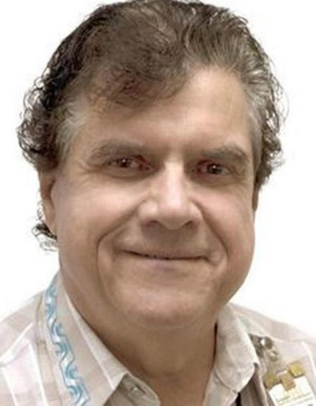
“…Complaints about a gynecologist for students at the University of Southern California went back decades. His behavior included sexual and racial comments, accounts of improper touching during pelvic exams and saving photographs of patients' genitals…” “…But the university didn't publicly acknowledge the history or reveal a report about the former physician's misconduct at the school's student health center until after it was contacted by the Los Angeles Times last week...”
Former USC Doctor Accused of Inappropriately Touching Patients (Jessica Ravitz, CNN 5/16/2018)

Slide 17
Further Commentary, LA Times:
More than 20 former and current USC employees interviewed … included nurses and medical assistants who'd served as chaperones and been in the room while Tyndall did exams. A number of them called his behavior “creepy.”
Patients, many of them Asian international students, stayed quiet, witnesses reported.
"Some of them had never had a gynecological exam before," one chaperone told the Times. "They are so innocent, a lot of them."
A number of complaints filed in 2013 by chaperones prompted an investigation by the university’s Office of Equity and Diversity… “no violation of school policy.”
Files kept from 1995 to 2014, were reviewed during an investigation in 2016, the USC president said in his letter. In them were accounts in which students said Tyndall made them “uncomfortable,” “gave me the skeevies,” and was “unprofessional.”

Slide 18
USC said Friday it had agreed to pay $215 million to former patients of Dr. George Tyndall, the first in what is expected to be a wave of payouts stemming from the sexual abuse scandal involving the longtime campus gynecologist. The proposed settlement would provide $2,500 to any USC student treated by Tyndall during his three-decade tenure and up to $250,000 to those who allege they were abused by him. As many as 17,000 students and alumnae are eligible, a university lawyer said. Manhattan Beach lawyer John Taylor, whose firm represents about 100 state court plaintiffs, said that while he was pleased USC had acknowledged wrongdoing, he planned to push forward with depositions of university administrators and requests to review internal school records. “We are still trying to figure out the cover-up and how it went on for so long,” he said. Tyndall left the university …under a secret deal that included a financial payout. His departure followed an internal investigation into allegations of sexual harassment and racially inappropriate remarks.
USC’s tentative $215M settlement in Tyndall abuse claims likely just the beginning of financial pain for the university (LA Times 10/19/18)

Slide 19
Dr. Johnny Barto/Conemaugh Medical Center (Johnstown, PA)
Rural pediatrician sexually abused both male and female patients (most between 8 – 12 yrs old) for over 20 years at both his office and hospitals that he had privileges at.
Barto was pillar of the community, sang in church choir, coached baseball/softball and served on the local school board.
He was originally accused of abuse in 1998 by several young patients but the community rallied around the doctor instead of the victims.
2000 people signed petition in support of Barto against these allegations.
Barto was exonerated in 2000 and continued to practice and abuse children until his 1/2018 arrest for abuse of a 12 yr old girl in December 2017. (17 years after his exoneration).
In March, 2019, Barto plead guilty to over 30 abuse charges and was sentenced to no less than 79 years in prison.
The civil litigation against the defendants remains ongoing.

Slide 20
David Kwiatkowski – Exeter Hospital (Exeter, NH)
Traveling hospital cardiac technologist infected at least 46 patients in 4 different states with Hepatitis C.
He stole painkiller syringes at the hospital, injected himself and replaced them with saline filled syringes tainted with his blood.
He had been fired at least four prior times for allegations of drug use and theft.
32 patients were infected in NH, 7 in Maryland, 6 in Kansas and one in Pennsylvania.
He plead guilty and sentenced to 39 years in prison.

Slide 21
Kristen Parker – Rose Medical Center (Denver, CO)
Surgical tech and admitted heroin addict injected pain killer syringes into herself and reused syringes filled with water or saline and contaminated with her tainted Hepatitis C blood.
At least 18 patients over a 2 year period became infect with Hep-C as a result and also suffered greatly due to no pain medication used during surgery.
Parker was sentenced to 30 years in prison.

Slide 22
Vickie Dawn Jackson/ Nocona General Hospital (Nocona, TX)
Longtime resident and night nurse at hospital injected multiple patients with a paralytic agent that temporarily halted breathing killing at least 10 patients, suspected in another 10 deaths.
There has been no motive for the killings.
Jackson plead no-contest to the charges on the eve of trial and received a life sentence.

Slide 23
Product & Equipment Failure
Description: Involves equipment that is faulty, has not been properly sterilized/maintained, or is misused, and results in harm to a number of patients. Can also involve faulty prescription drugs or compounds.
Theories: Product Liability/defective design; Failure to follow manufacturer’s instructions; human error or malfeasance
Illustrative Cases:
New England Compounding Center (meningitis outbreak affecting over 750 individuals and 64 deaths arising from contaminated steroids)(multi-state)
Serious infection protocol failures resulting in 11 children dead at Nursing/Rehab facility. (Wanaque, NJ)
Olympus duodenoscopes (fatal infections to unknown number of patients, including 35 known deaths, due to exposure to contaminated scopes)(multi-state)
3000 patients possibly exposed to HIV, Hepatitis due to improper sterilization. (Saddle Brook, NJ)
Desai (Vegas endoscopy clinic Hep C outbreak, 63,000 patients notified)(Clark County, NV)

Slide 24
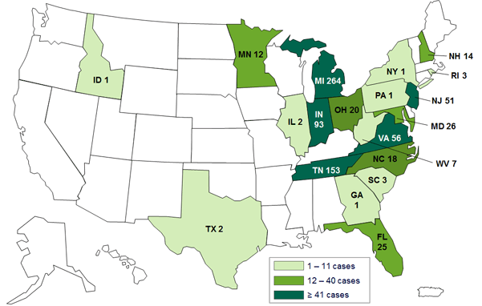
Case Studies: NECC
On October 30, 2015, CDC updated its web resources or patients and clinicians. Patients affected by tainted steroid injections from the New England Compounding Center continue to receive treatment for their infections and clinicians should continue to monitor patient recovery. $200M settlement.
Persons with Fungal Infections Linked to Steroid Injections, by State
https://www.cdc.gov/hai/outbreaks/meningitis-map-large.html

Slide 25
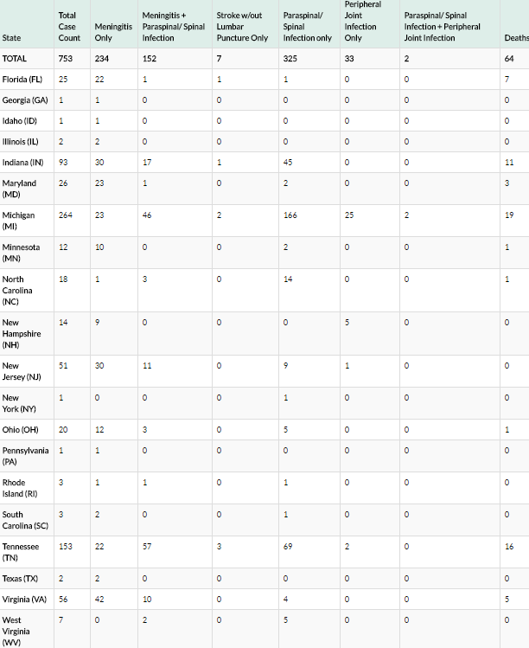
Case Studies: NECC (con’t)
Cases and Deaths with Fungal Infections Linked to Steroid Injections
https://www.cdc.gov/hai/outbreaks/meningitis-map-large.html

Slide 26
Improper infection control procedures (Wanaque, NJ)
Death of 11 children following viral outbreak at Center for Nursing and Rehabilitation. A total of 34 pediatric cases were associated with this infection outbreak.
All of the pediatric cases involved children with severely compromised immune systems due to other medical conditions.
State of NJ prohibited new patients from being admitted to facility in November 2018 due to “serious infection control deficiencies”.
NJ Dept of Health revealed lapses in infection control/washing during a surprise inspection.
The report revealed nurses and other personnel either did not wash their hands in between touching equipment attached to patients and themselves or other equipment, nor did some wash their hands for the required time after doing so.

Slide 27
Improper sterilization of surgical equipment. (Saddle River, NJ)
An ambulatory surgery center in northern NJ potentially exposed thousands of patients to HIV and Hepatitis due to “lapses in infection control” and sterilization of instruments.
NJ Dept of Health opined that more than 3,700 patients who had procedures at HealthPlus Surgery Center in Saddle Brook, NJ may have been exposed to blood-borne illnesses such as HIV, Hepatitis B and Hepatitis C.
These patients underwent procedures at the facility between January 1 and September 7, 2018.
The department found that members of HealthPlus staff were not following proper sterilization procedures and “failed to comply with other regulations regarding the dispensing and storage of medication, as well as infection control planning and procedures” according to a HealthPlus Surgery Center statement.
As a result, a class action lawsuit has been filed against the facility in October 2019.

Slide 28
Case Studies: Product & Equipment Failure
Illustrative Issues
Deep pocket search
“Batching” of defendants, i.e., Manufacturers, Physicians, Hospitals, Pharmacies, Sister companies
Civil v criminal allegations
Jurisdictional issues
To Class or not to Class
Notes:
Rich & Kristin

Slide 29
Financial Batch Claims, a New Breed of Batch Claims
Description:
These claims focus on the business side of healthcare brought upon by: hospital mergers and acquisitions; shrinking reimbursements ; need for investment capital, healthcare reform / new payment models, claiming that such factors result in systemic flaws and creating enterprise-wide liability. They tend to focus on the business of healthcare delivery rather than the medical outcome
Theories:
The type and quality of care received from the was medically inappropriate, not because of medical negligence, but because of financial pressure to contain costs/produce revenue. May also involve follow on suits from government investigations.
Inventive plaintiff attorneys may ask a jury to “help me understand why my 125 clients did not receive the standard treatment for their cancer — was this denial of care based on money, managed care contracts, bundled payments?”¹
Notes:
Kristin & Rich

Slide 30
Financial Batch Claims
Illustrative cases:
Intuitive Surgical/Da Vinci Robots (Multi-state)
Allegation of institutional preference to use more costly technology when standard procedure may produced similar results
1,000+ patients filed actions against Intuitive including more than 100 patients who died; various institutions also implicated
In 2013, Intuitive set aside $67M to resolve the pending claims.
Drs. Schlicht & Bryant (Otero County, NM)
Allegation of management company turning a blind eye to use of use of costly, revenue-producing off-label bone cement procedure
74 patients allege harm; $32M+ paid to date in settlement; litigation ongoing
Dr. Midei/Cardiac Stent Cases (Baltimore, MD)
Medical necessity questioned in relation to insertion of stents in over 500 patients at St. Joseph Hospital
$37M patient settlement with follow-on regulatory action filed, which settled for $22M
Dr. Farid Fata (Detroit, Michigan)
Physician intentionally misdiagnosed patients with cancer and provided subsequent treatment; over 550 patients received medically unnecessary infusions or injections
Pleaded guilty to 13 counts of Medicare fraud, one count of conspiracy to pay or receive kickbacks and two counts of money laundering. Sentenced to 45 years.
To Fata, "patients were not people. They were profit centers”
Allegations that various institutions failed to intervene because of interest in profits

Slide 31
Batch is on the Rise
Spikes in Frequency of Batch Claims – Why?
Advances in Technology, such as:
Unnecessary cardiac stent procedures
Intuitive robotic surgeries
Spine surgeries—experimental
Genetic testing
Increasing revenue pressures upon healthcare systems to increase number of procedures performed
Healthcare institutions view liability insurance policies as backstopping their business decisions to invest or promote medical procedures which may ultimately be deemed to fall below the standard of care.
#MeToo movement has given strength to victims to speak up against their abusers.
More aggressive/creative plaintiffs bar that enlists social media to sign up dozens, hundreds and even thousands of patients to obtain class action status to force healthcare institutions into expedited settlements
Notes:
Lainie

Slide 32
Risk Management: High Risk Review
Larger healthcare systems with a high number of employed or contracted physicians where compensation is tied to volume of procedures or revenue producing procedures (i.e., economic credentialing).
Rural or Community Hospitals that may be in greater need of physicians may be inclined to overlook “red flags” in order to ensure proper staffing.
Need for nurses and staff that may require traveling employees without proper background checks.
Recent investments into certain volume enabling technology or equipment.
Rising or large revenues around certain procedures.
Whistleblower or DOJ investigation concerning medically unnecessary procedures.
Notes:
Lainie

Slide 33
Risk Management Strategies
Expansion of Risk Management oversight to all operational areas
Review of credentialing processes
MUST review ALL incoming physicians, regardless of reputation.
Attention to “outlier” procedures and revenue generation
Investigate thoroughly all patient’s complaints of abuse or inappropriate behavior by any staff.
Focus on compliance with organizational policies and procedures.
INSURANCE , INSURANCE, INSURANCE
With focus on terms and insurance partners – THIE is your best resource for dealing with this ever changing landscape.

Slide 34
Risk Management Strategies: If a Batch Occurs…
If incident is ongoing, escalate internally per protocol, including calling general counsel and outside legal counsel
Stop the bleeding if the incident is ongoing
Investigate/consider contacting law enforcement
Assess whether or not there have been HIPAA or other security breaches
Communicate and coordinate with internal PR and external crisis management teams
Legal analysis of the situation
Call your insurance carrier to put the carrier on notice

Slide 35
Opioid-related litigation: It is far too early for the MPL world to go to sleep and assume these will be “just” product-related Cyber: Still a developing exposure with potential massive downside; we can only expect the scope of cyber claims to increase in complexity as well as well as potentially impacting MPL interests more directly Cannabis: In many ways, this is a blank canvass. We know the plaintiff’s bar already has the brushes…will we be ready when they start painting?
And if these examples were not enough…what could be looming on the horizon?

Slide 36
This discussion only scratched the surface of what we see in the “Batch” claim world…

Slide 37
David P. Kreppein, Assistant Vice President 212-365-2037 dkreppein@transre.com
Questions

