Slide 1
What Do They See When They See You?
Texas
Hospital Insurance Exchange
March 4, 2020
10:15am to 11:15am
Alice Dendinger. SPHR
alice@gotoaag.com
512-779-3236
www.AustinAllianceGroup.com

Slide 2
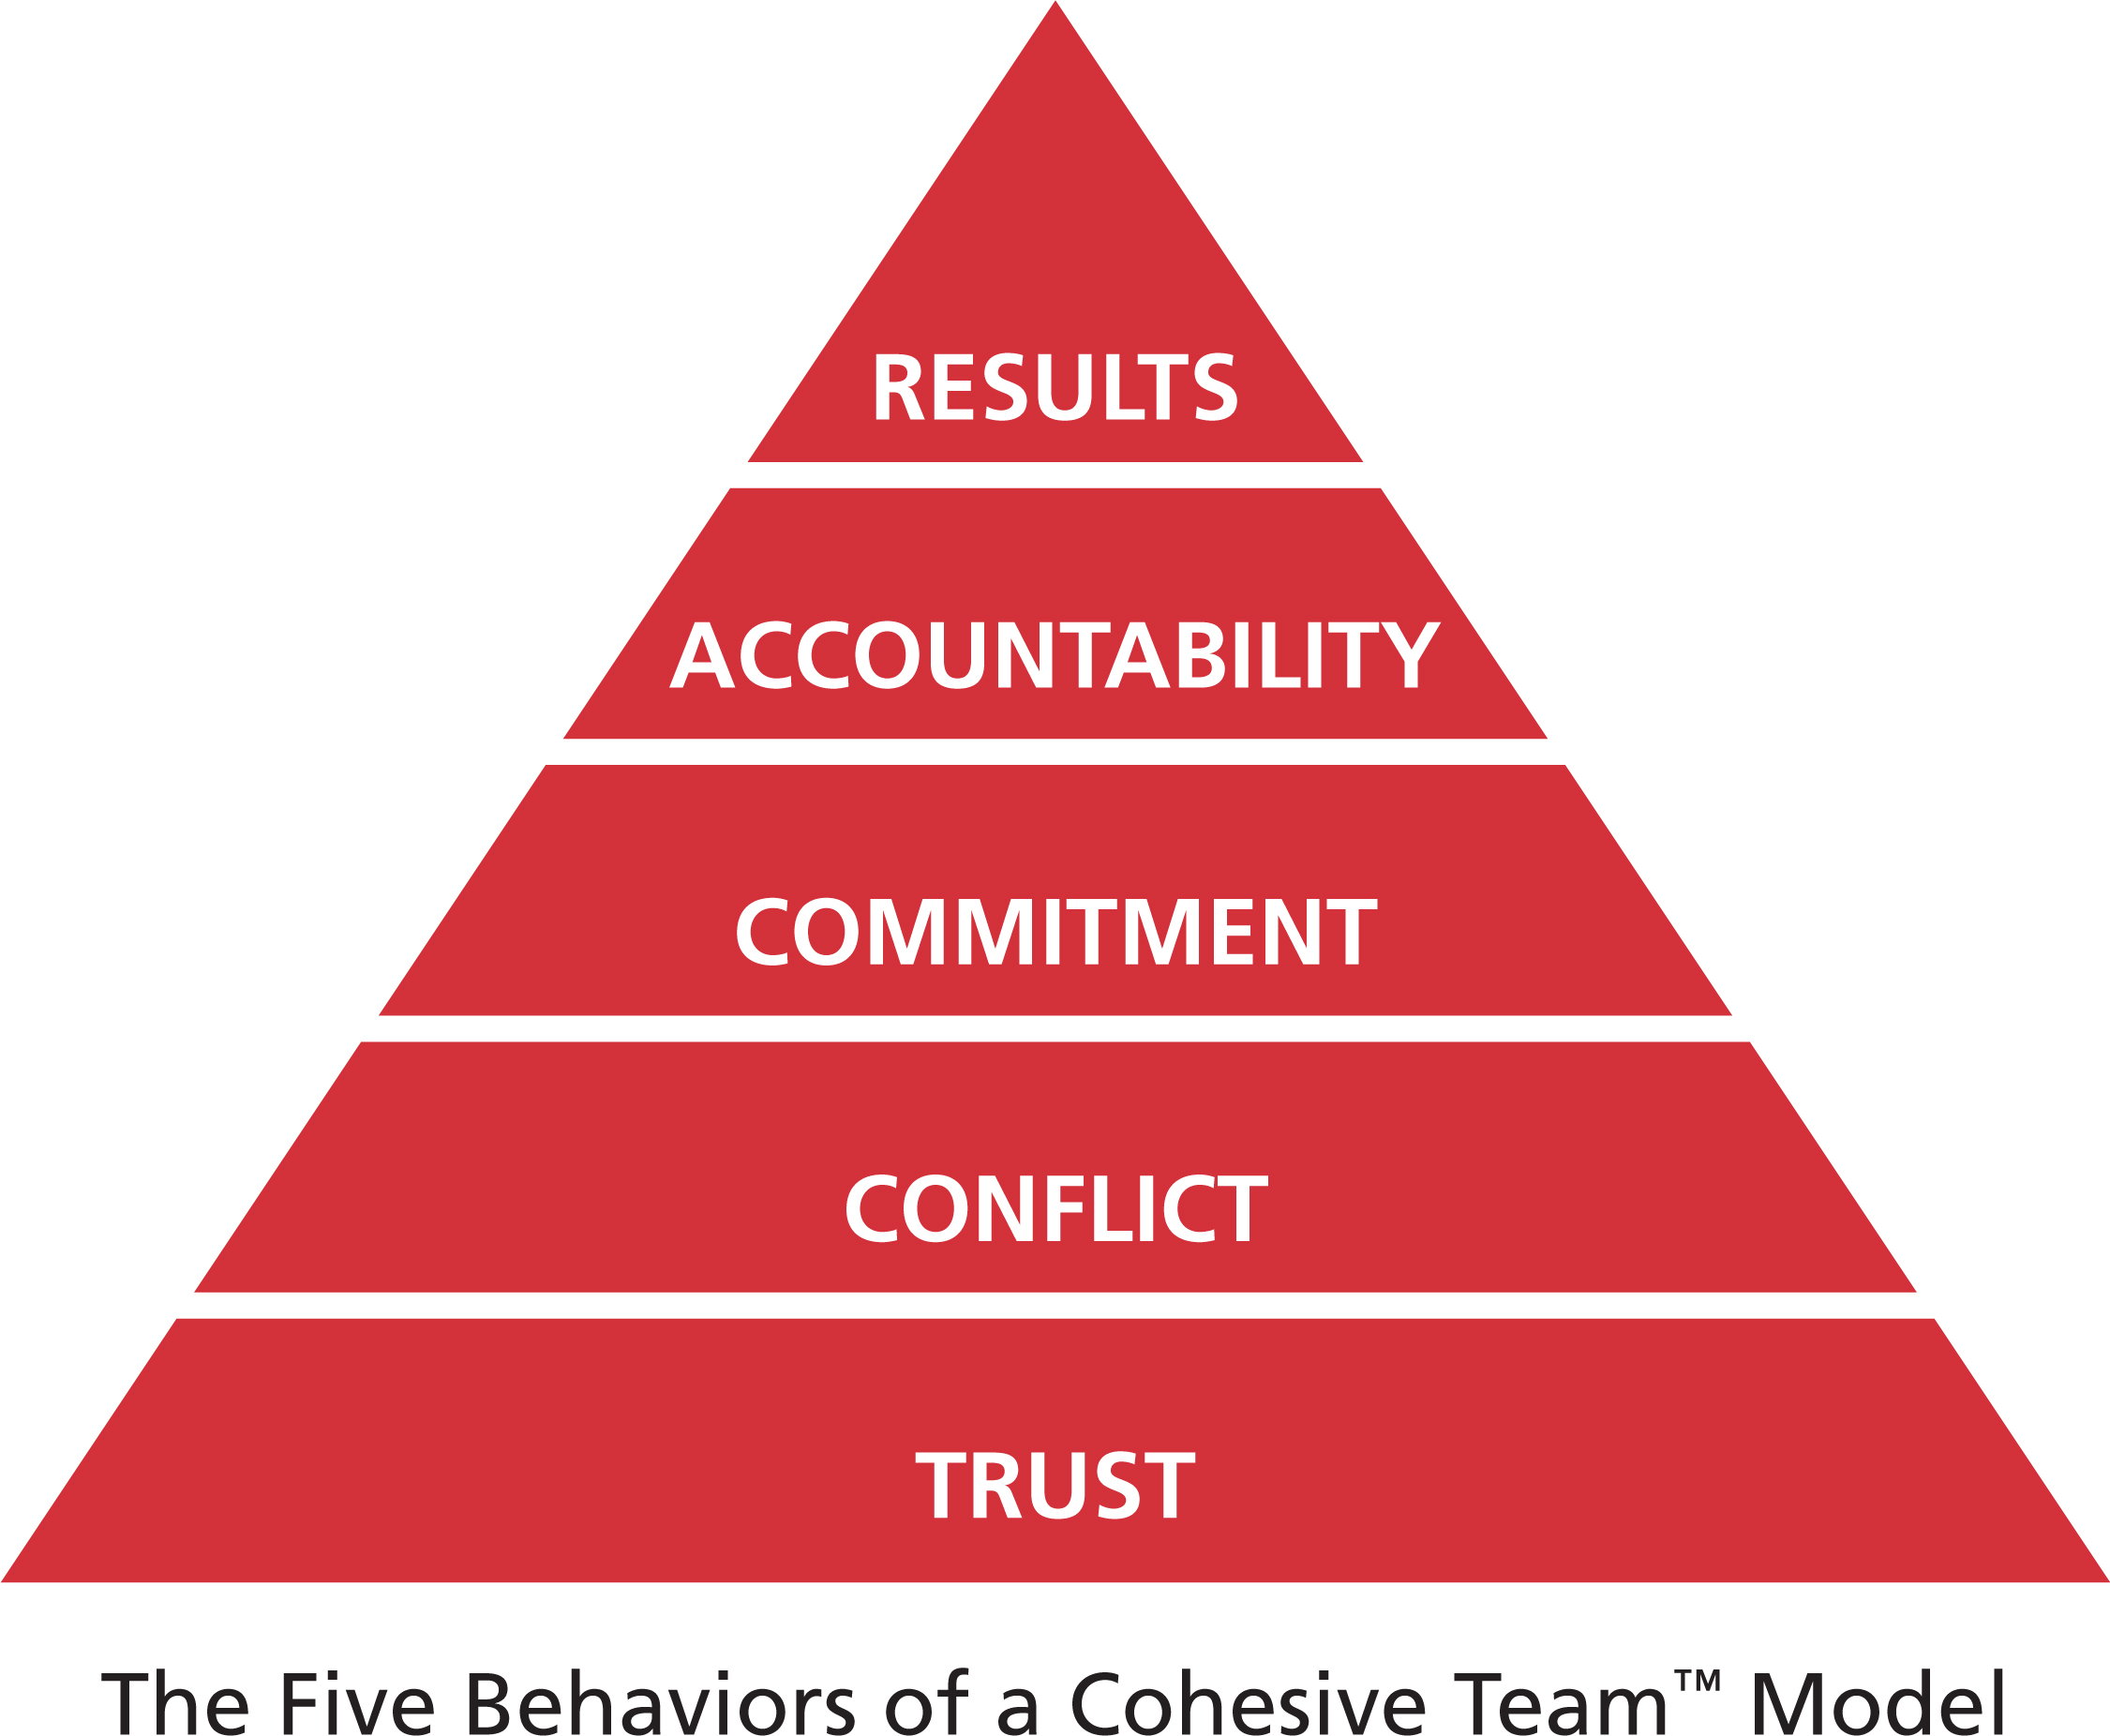
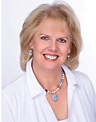
Alice Dendinger
SPHR

Slide 3
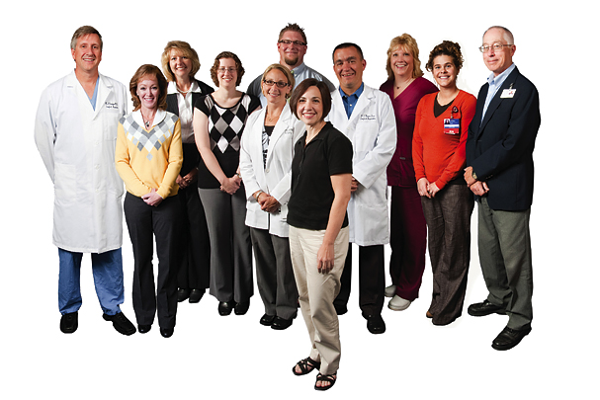
“For people, brands are important because they represent their unique blend of talents, strengths, skills, and knowledge, giving them an advantage in a competitive market.”
Your Personal Brand: What others think or believe of you and how they experience you is up to you.
You have a “brand” that people see or visualize when they
hear your name or see you.
“Essentially, a brand stands for a singular idea or concept that a company or product “owns” inside the mind of a customer or prospect.”
What Do They See When They See You?

Slide 4
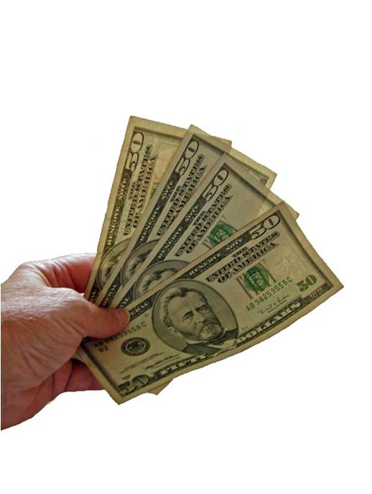
At the end of the day people won't remember what you said or did, they will remember how you made them feel - Maya Angelou

Slide 5
How They See You
Your Brand
Is Critical to your Success

Slide 6
Four Steps to Becoming your own
Brand Manager
Discover Your Brand - The It You do not Get
Define your Brand – Who you are!
Declare your Brand – Say it!
Deliver on your Brand – Do it!

Slide 7
Establish your Brand Board of Directors
Before You Do Anything……………………

Slide 8
1. Discover Your Brand
Notes:
1 minute
say: Have you ever wondered why it’s so easy to work with some people and more challenging to work with others? Let’s begin by looking at some basic differences among people. In the front of the room, I have a poster labeled “Fast-Paced & Outspoken.” The other words on this chart are “Active,” “Assertive,” “Dynamic,” and “Bold.” In the back of the room, there is another poster labeled “Cautious & Reflective.” The other words on this chart are “Moderate-Paced,” “Calm,” “Methodical,” and “Thoughtful.”

Slide 9
Your Number One Road Block in Life is You

Slide 10
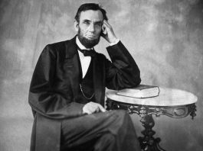
“Folks are usually about as happy as they make their minds up to be.”
Abraham Lincoln

Slide 11
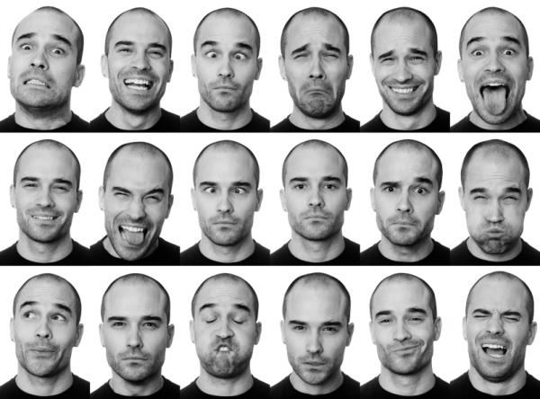

Slide 12
Discover Your Brand
Page 4
Discover The It You Do Not Get | YOU KNOW | YOU DON’T KNOW
OTHER’S KNOW ABOUT YOU
OTHERS DON’T KNOW ABOUT YOU
Our Blind Spot – The It
we do not get
Open
What is hidden –
The Mask
The
Unknown

Slide 13
2. Define Your Brand

Slide 14
Select Six Words that best describe you – Your Values
Appreciative | Assertive | Ambitious | Achievement Oriented | Listener | Leader
Astute | Attentive to details | Authentic | Analytic | Loyal | Logical
Authoritative | Committed | Compassionate | Competent | Makes a Difference | Mission Focused
Continuous Learner | Cooperative | Courageous | Creative | Open communicator | Optimistic
Candid | Cautious | Charismatic | Cheerful | Orderly | Outgoing
Clever | Collaborative | Consistent | Controlling | Patient | Tenacious
Dependable | Diplomatic | Diligent | Driving | Powerful | Pioneering
Dynamic | Effective | Empathic | Enthusiastic | Playful | Practical
Efficient | Ethical | Fair | Family Oriented | Precise | Prepared
Financially Motivated | Forgiving | Friendly | Flexible | Punctual | Quality Service
Firm | Generous | Honest | Humble | Rational | Realistic
Humor/Fun | Independent | Integrity | Takes Initiative | Respectful | Responsible
Impulsive | Imaginative | Innovative | Influencer | Risk Taker | Responsive
Gives Recognition | Confident | Resilient | Sensitive | Safe | Successful
Strong | Sympathetic | Technically skilled | Thorough | Trustworthy | Visionary
Versatile | Wise | Warm | Works well with others | By the Book | Stubborn
Define Your Brand
Page 5
Select Six Words that
Best Describe you
Test the Validity of Your Answers:

Slide 15
Define Your Brand
Pages 6 and 7

Slide 16
3. Declare Your Brand – Say It

Slide 17
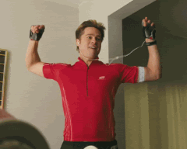
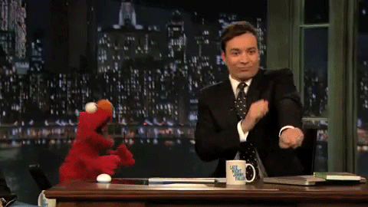
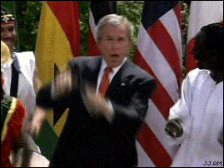
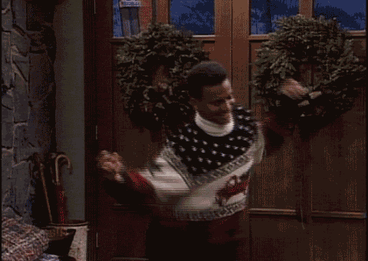
What do others need to know about Your Brand to bring out the best in you?
Declare Your Brand
Page 8

Slide 18
4. Demonstrate Your Brand – Do It

Slide 19
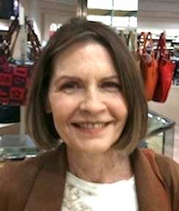
What Does Your Look Convey?
How do you package your brand?

Slide 20
BRAND Action Plan
Demonstrate Your Brand
Page 9
Don’t Look Back
You’re Not Going
That Way

Slide 21
I Want for You
What You
Want For You…
What Do You Want?

Slide 22
THIE Presentation
Pages 10 and 11
Alice Dendinger
SPHR

